Slide 1


Titolo presentazione sottotitolo
HANDY: a wireless sensorized glove
for ASL fingerspelling gesture recognition
Milano, XX mese 20XX
Ilaria Crupi
Arianna De Vecchi
Diana Nigrisoli
Professor: Pietro Cerveri
Tutor: Matteo Rossi
July, 26th 2023

Slide 2

Project Aim
Contents
Hardware
Firmware
Acquisition Protocol
Handy
Software
Project 04 - Crupi, De Vecchi, Nigrisoli

Slide 3
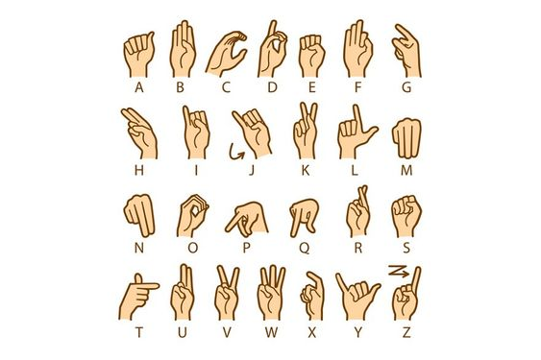

Project Aim
Develop a smart glove able to teach the American Sign Language (ASL) to people who are unfamiliar with it.
Hardware
Firmware
Hearing loss affects more than 1.5 billion people, nearly 20% of the global population [1].
This communication barrier adversely affects the lives and social relationships of these people.
Acquisition Protocol
Software
Provide ASL education in the form of a game.
[1] https://www.who.int/health-topics/hearing-loss. Accessed on 23 July 2023
Project 04 - Crupi, De Vecchi, Nigrisoli

Slide 4
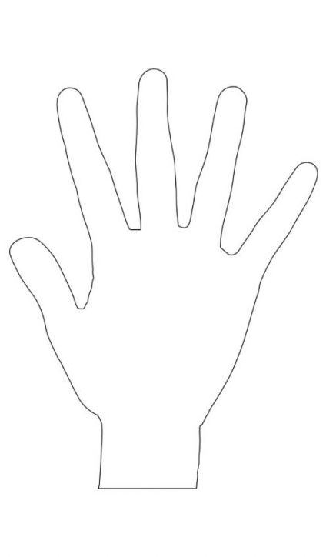
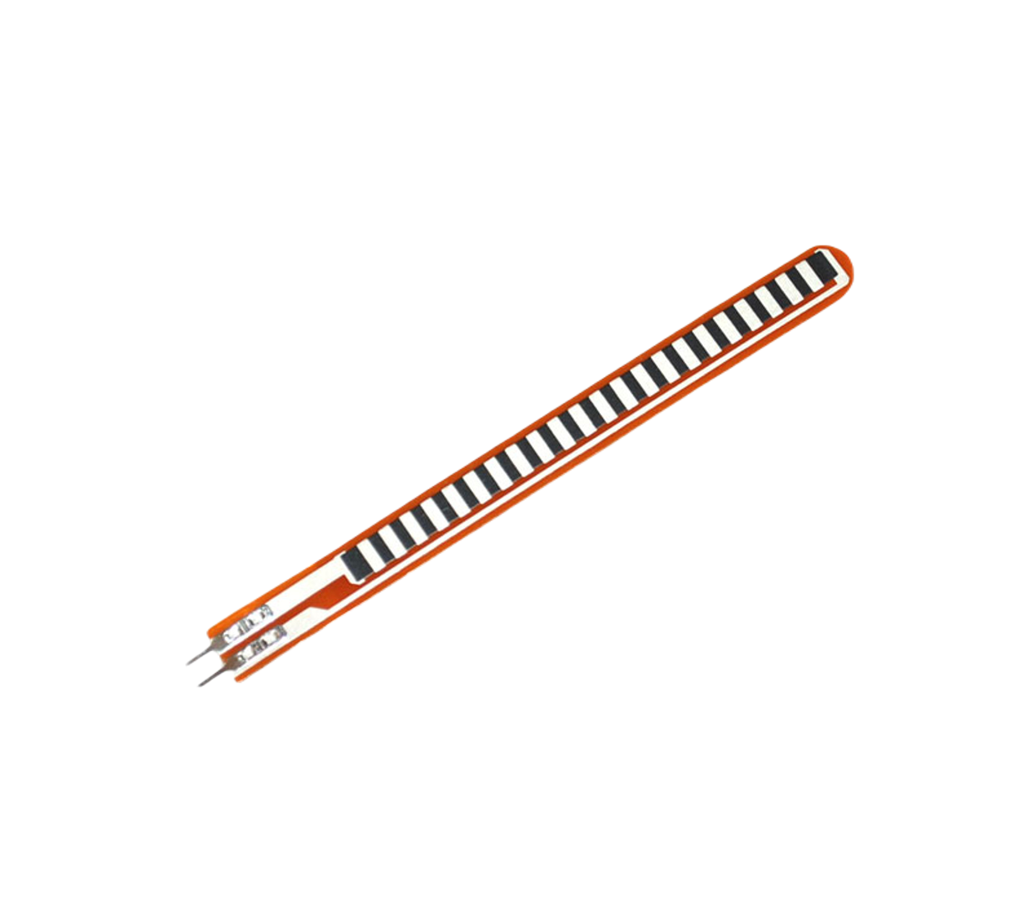
Hardware
5 flex sensors: one on each finger
Firmware
Acquisition Protocol
Software
Project 04 - Crupi, De Vecchi, Nigrisoli

Slide 5
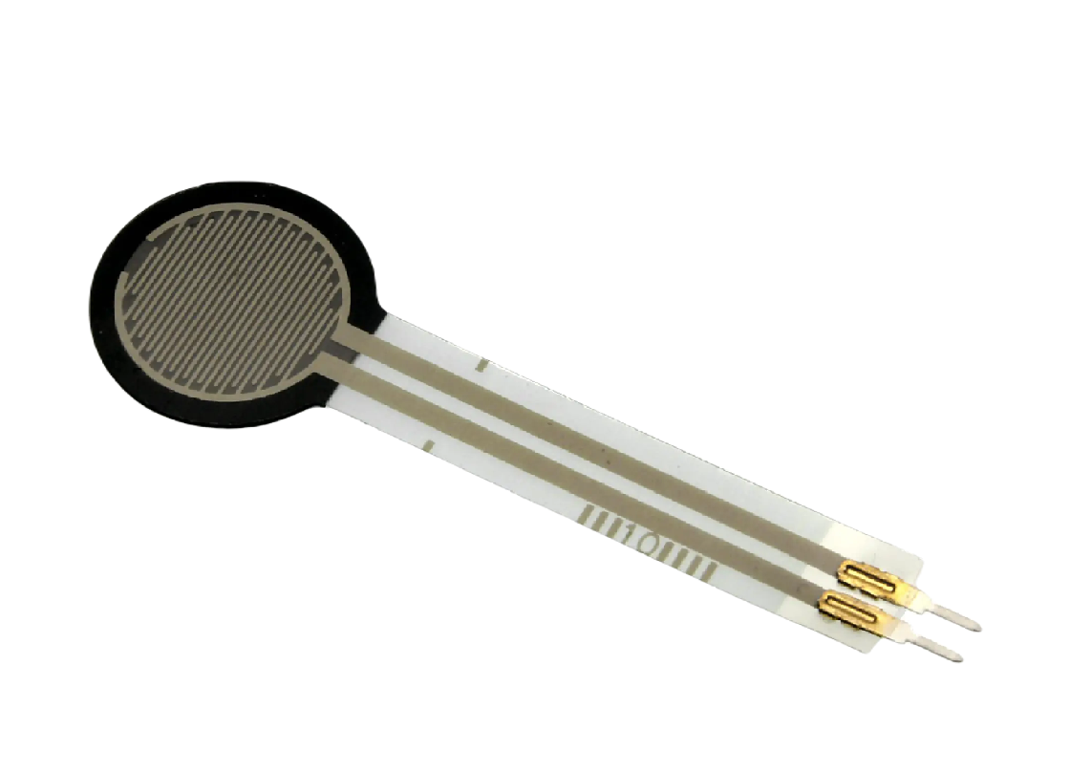
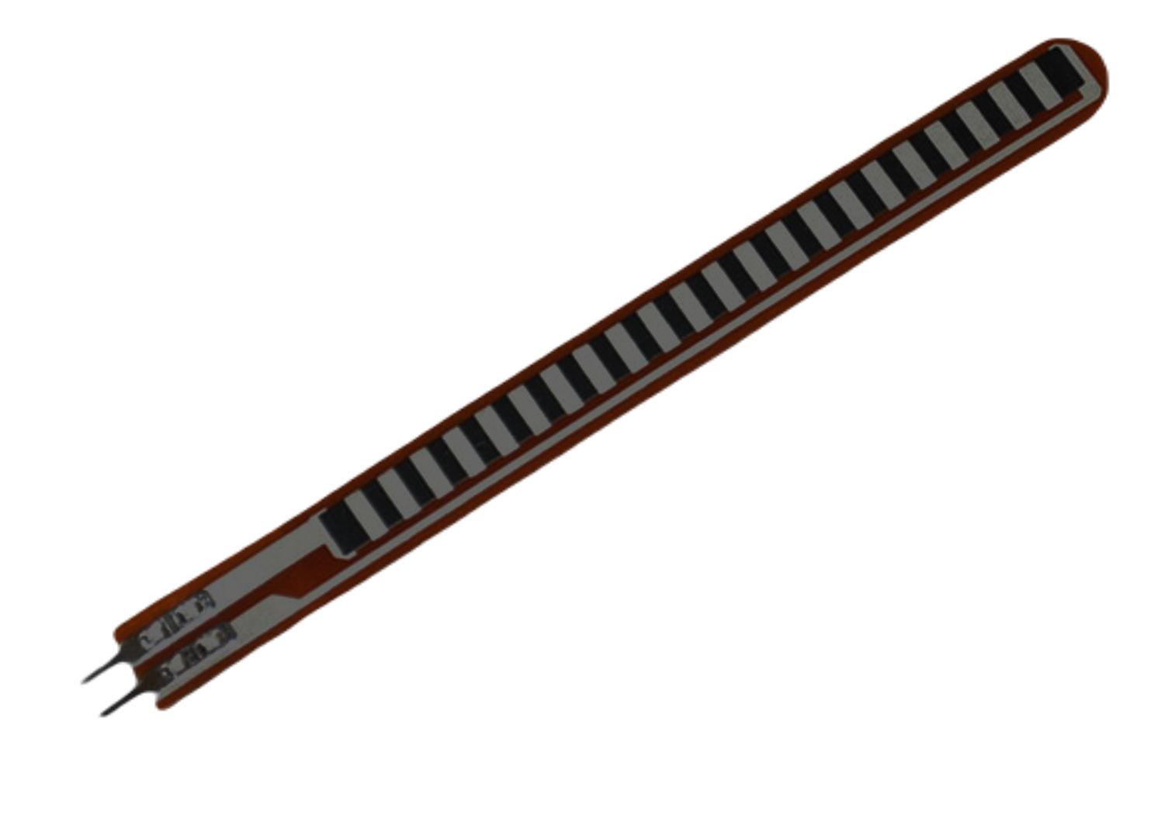
Hardware
5 flex sensors: one on each finger
2 force sensors: between index and middle finger and under the thumb
Firmware
Acquisition Protocol
Software
Project 04 - Crupi, De Vecchi, Nigrisoli

Slide 6
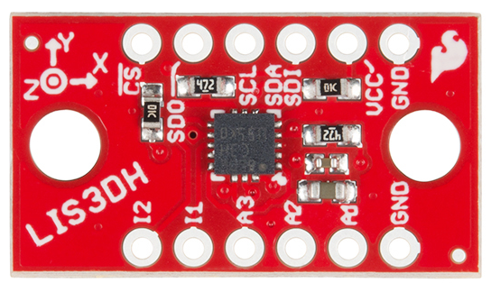
Hardware
5 flex sensors: one on each finger
2 force sensors: between index and middle finger and under the thumb
3-axis accelerometer
Firmware
Acquisition Protocol
Software
Project 04 - Crupi, De Vecchi, Nigrisoli

Slide 7
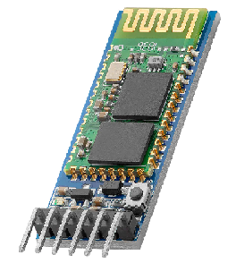
Hardware
5 flex sensors: one on each finger
2 force sensors: between index and middle finger and under the thumb
3-axis accelerometer
HC05 Bluetooth module
Firmware
Acquisition Protocol
Software
Project 04 - Crupi, De Vecchi, Nigrisoli

Slide 8
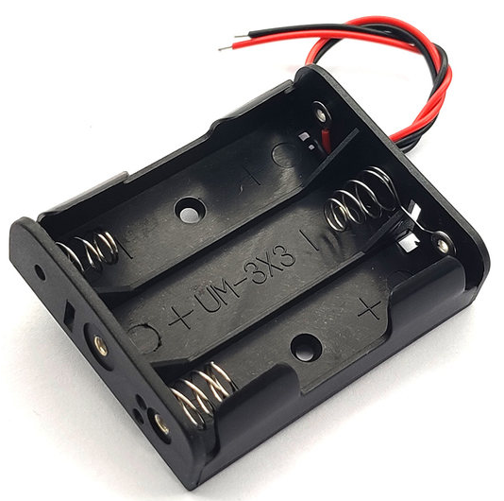
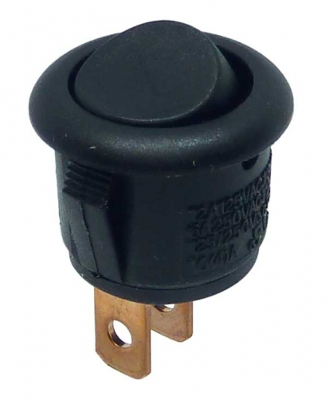
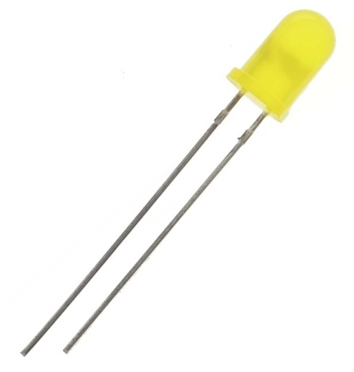
Hardware
5 flex sensors: one on each finger
2 force sensors: between index and middle finger and under the thumb
3-axis accelerometer
HC05 Bluetooth module
PSoC microcontroller
4.5V battery + 3.3V LDO
Yellow LED
Round Switch
Firmware
Acquisition Protocol
Software
Project 04 - Crupi, De Vecchi, Nigrisoli

Slide 9
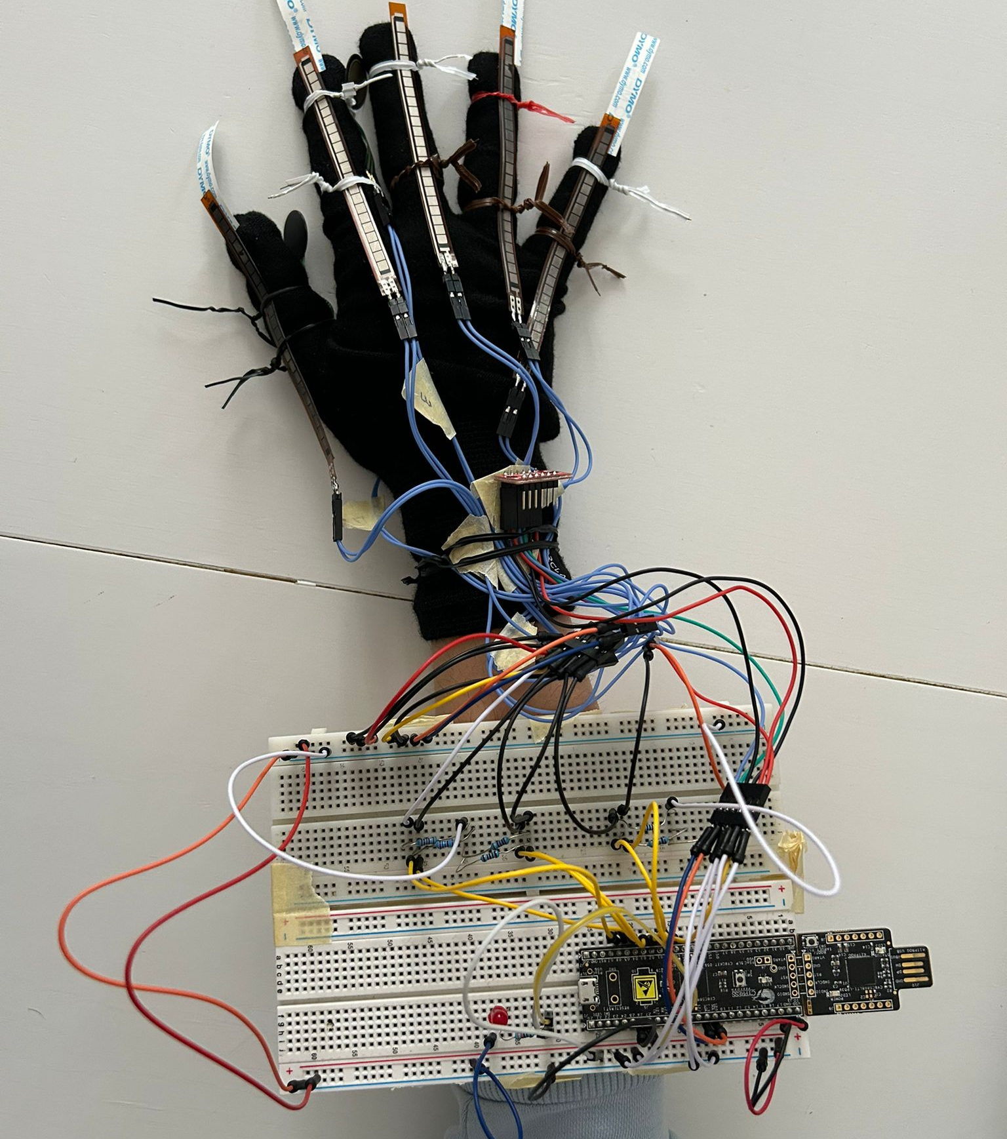
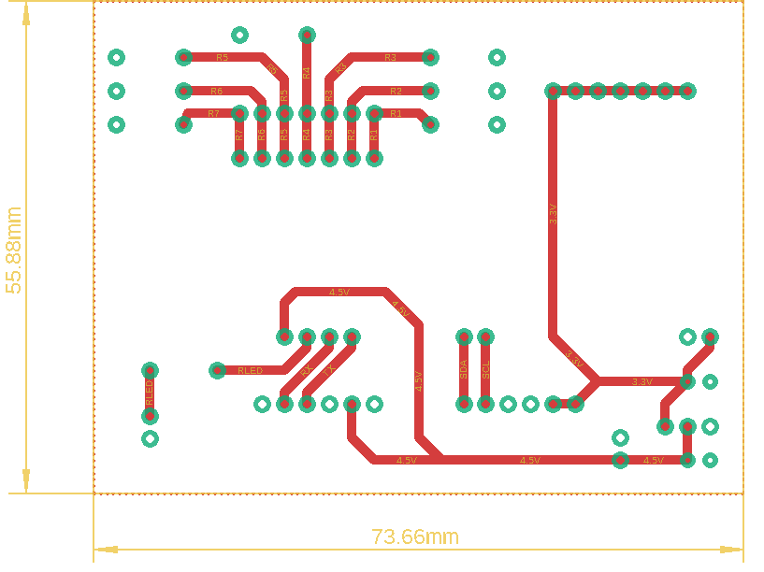
Hardware
Tests with breadboard
PCB Design
Firmware
Acquisition Protocol
Software
Project 04 - Crupi, De Vecchi, Nigrisoli

Slide 10
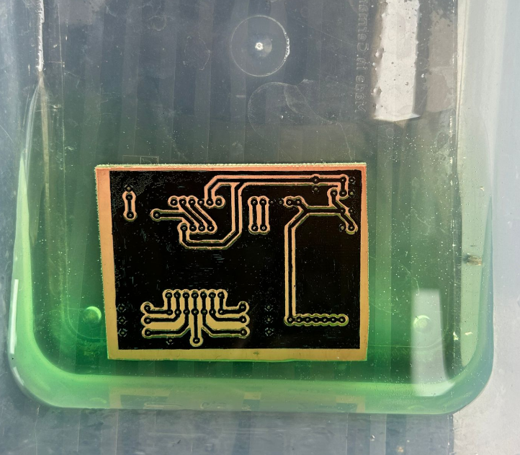
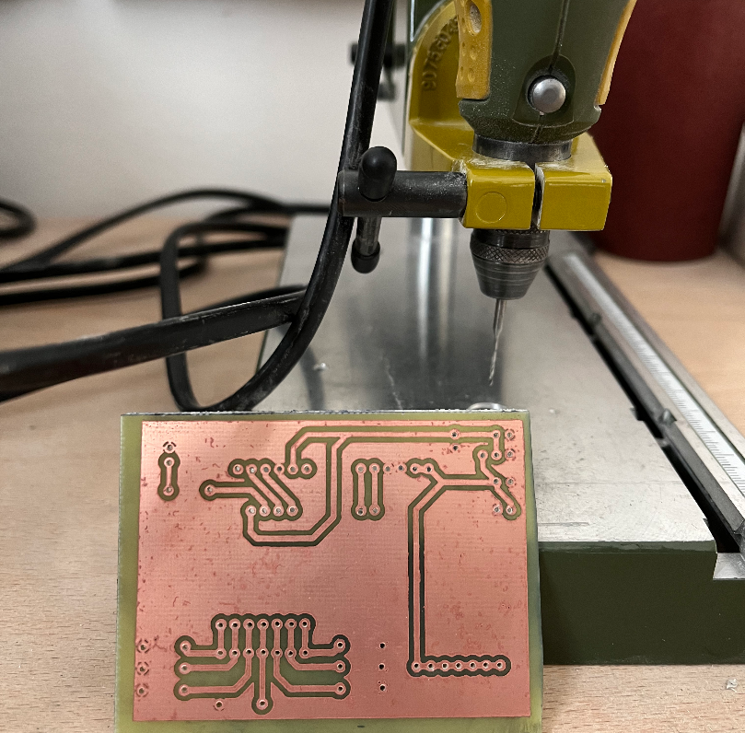
Hardware
PCB Production
Drill and soldering
Firmware
Acquisition Protocol
Software
Project 04 - Crupi, De Vecchi, Nigrisoli

Slide 11
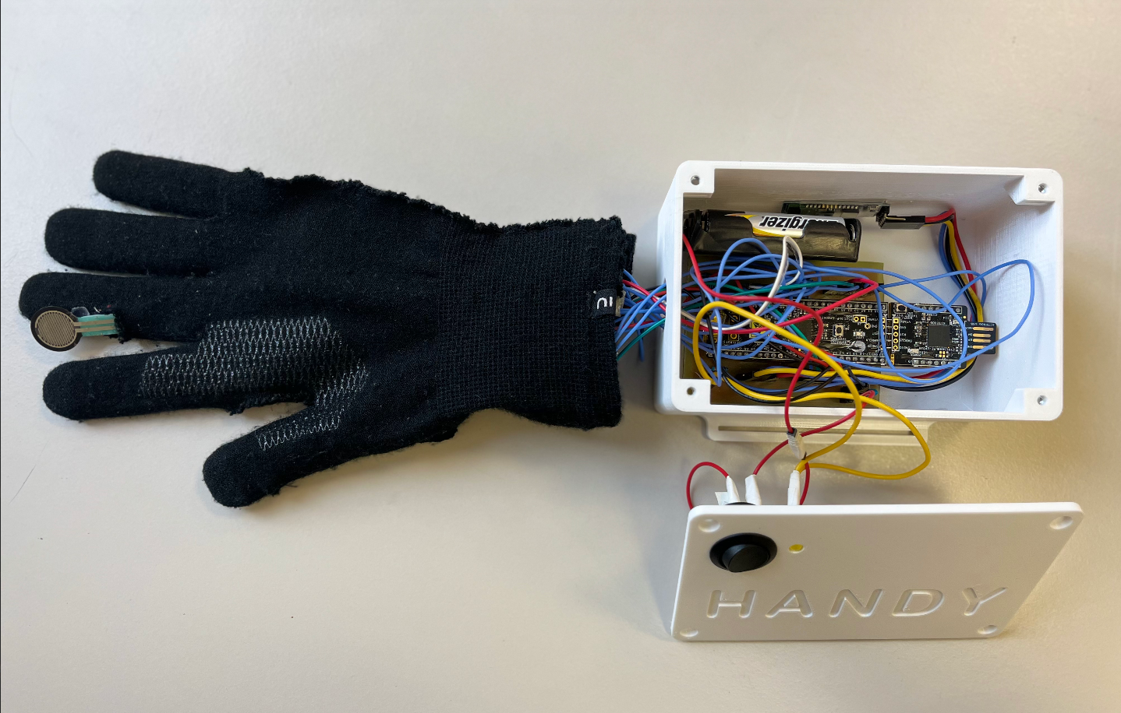
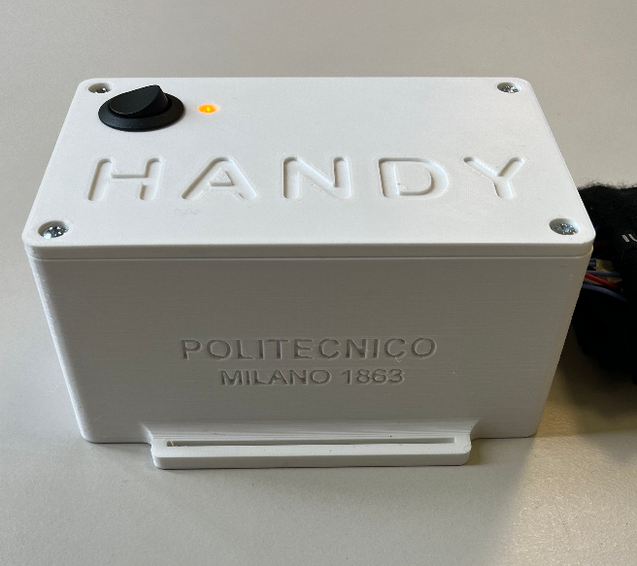
Hardware
3D printed case and final implementation
Firmware
Acquisition Protocol
Software
Project 04 - Crupi, De Vecchi, Nigrisoli

Slide 12

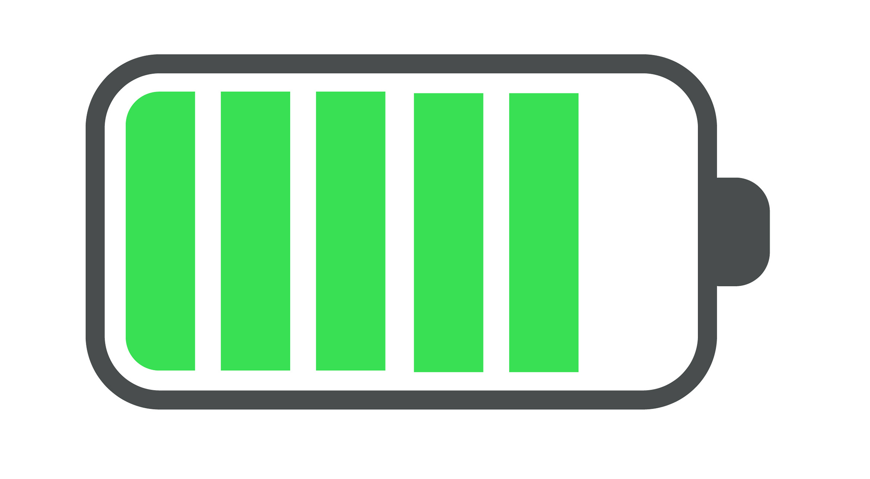

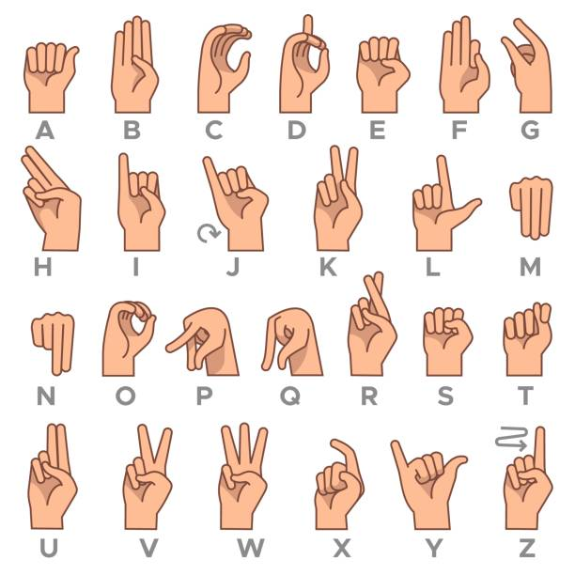

Firmware
Acquisition Protocol
Software
UART
Timer
VFD
Flex sensors
Custom cables
MUX
(7 channels)
I2C
read ACC
Force sensors
PCB
10 samples avg
Handy
ASL gesture
Accelerometer
ADC
Sensorized glove
Microcontroller
Project 04 - Crupi, De Vecchi, Nigrisoli

Slide 13
Acquisition Protocol
Software
For every subject:
Perform all the alphabet
Do 3 more gestures:
‘open’ Hand fully open with the back facing the subject
‘closed’ Hand completely closed
‘dummy’ Hand fully open with palm facing upwards
Repeat at least two times
Project 04 - Crupi, De Vecchi, Nigrisoli

Slide 14
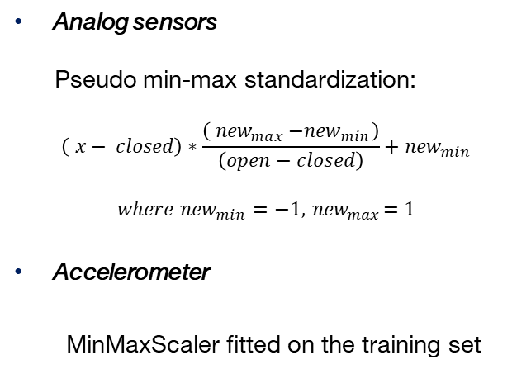
Software - ML
A Machine Learning approach for hand gestures classification was developed
Data Scaling
Classification models
Analog sensors
Pseudo min-max standardization:
$$\left( x− closed\right)∗\frac{\left({ new}_{max}{−{new}_{min}}\right)}{\left(open−closed\right)}+{new}_{min}$$
$$where {new}_{min}=−1,{ new}_{max}=1$$
Accelerometer
MinMaxScaler fitted on the training set
K Nearest Neighbours
Classification Tree
Random Forest
Adaboost
Logistic Regression
Multilayer Perceptron
Project 04 - Crupi, De Vecchi, Nigrisoli

Slide 15
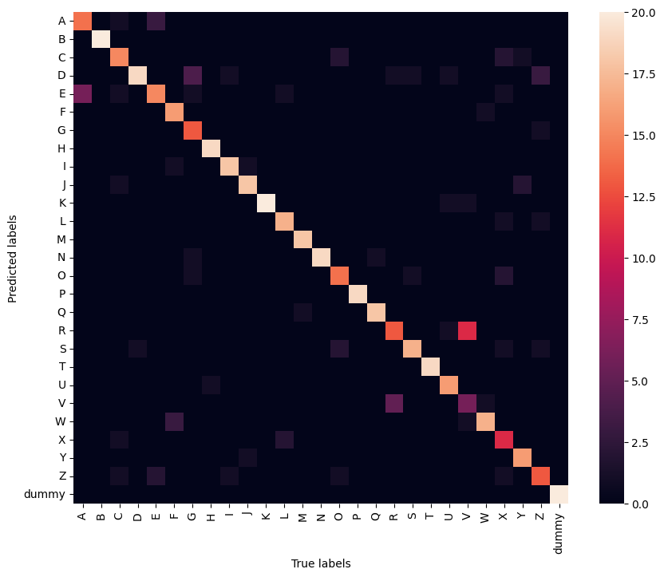
Software - ML
The best model turned out to be Random Forest
'criterion': 'entropy’,
'max_depth': 12,
'min_samples_leaf': 5,
'min_samples_split': 12,
'n_estimators': 150
F1 score | Train set | Test set
 | 0.900 | 0.835
Project 04 - Crupi, De Vecchi, Nigrisoli

Slide 16
Software - ML
The best model turned out to be Random Forest
Easily confused
Well classified
Project 04 - Crupi, De Vecchi, Nigrisoli

Slide 17
Software – GUI
The GUI is designed as a video game that tests the user’s ability in ASL spelling.
It is composed of 5 windows:
Statistics
Log-in
Menu
Game
Calibration
Project 04 - Crupi, De Vecchi, Nigrisoli

Slide 18
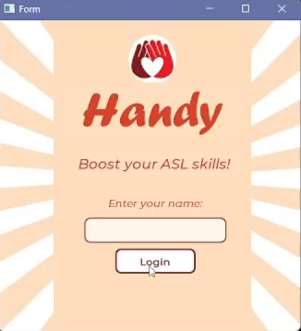
Software – GUI
Log-in
Log-in with username
If there is no username, it gives an error
Menu
Automatic connection to COM when starting the game
Statistics
Log out
Project 04 - Crupi, De Vecchi, Nigrisoli

Slide 19
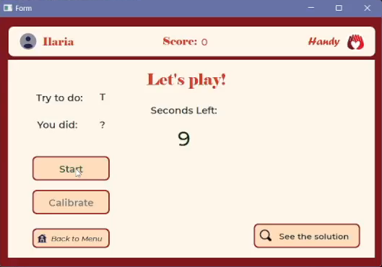
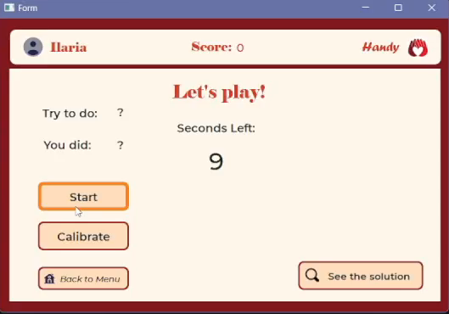
Software – GUI
Game
Random letter provided when pushing «Start»
10 seconds to make the right gesture
The ML model gives a prediction on the letter performed. If the prediction matches the actual letter, the score increases.
Project 04 - Crupi, De Vecchi, Nigrisoli

Slide 20
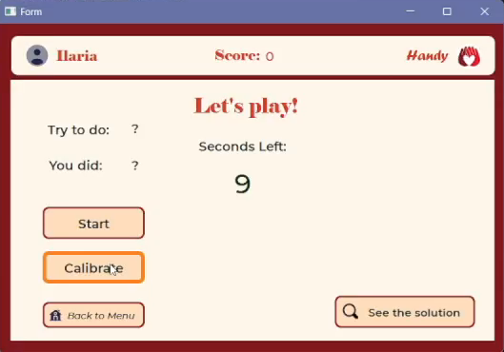
Software – GUI
Calibration
Calibration consists in a 2-step procedure:
Hand fully open
Hand completely closed
Calibration must be performed at least once. The device acquires and saves the calibration data into a csv file specific for each user.
Project 04 - Crupi, De Vecchi, Nigrisoli

Slide 21
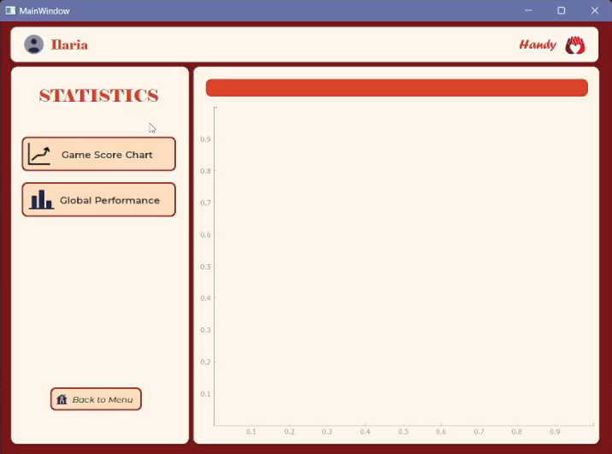
Software – GUI
Statistics
Total Score Chart allows the user to analyze the performance among different rounds (days)
Global Performance Bar Chart shows the percentage of success for each letter
Project 04 - Crupi, De Vecchi, Nigrisoli

Slide 22

Thank you!

